Slide 1


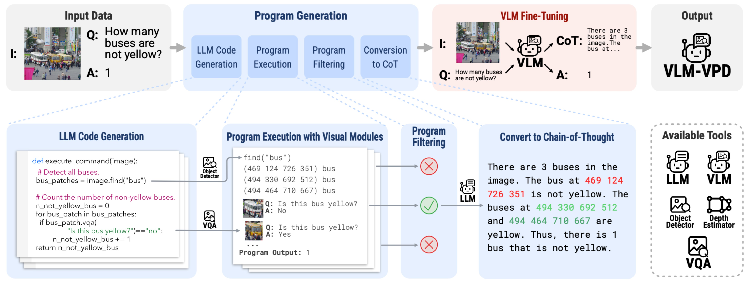
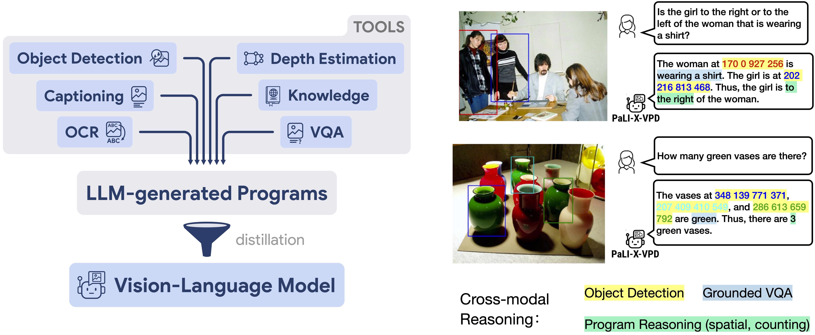
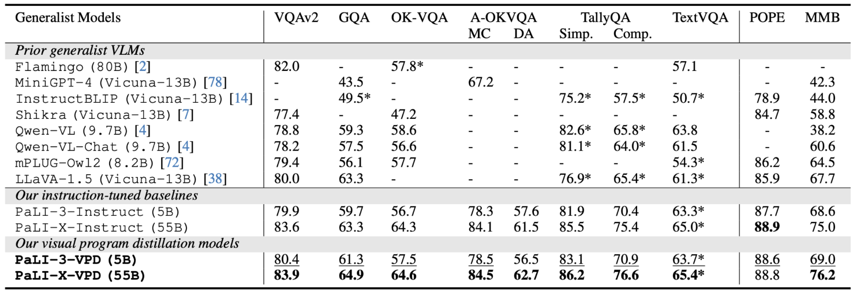
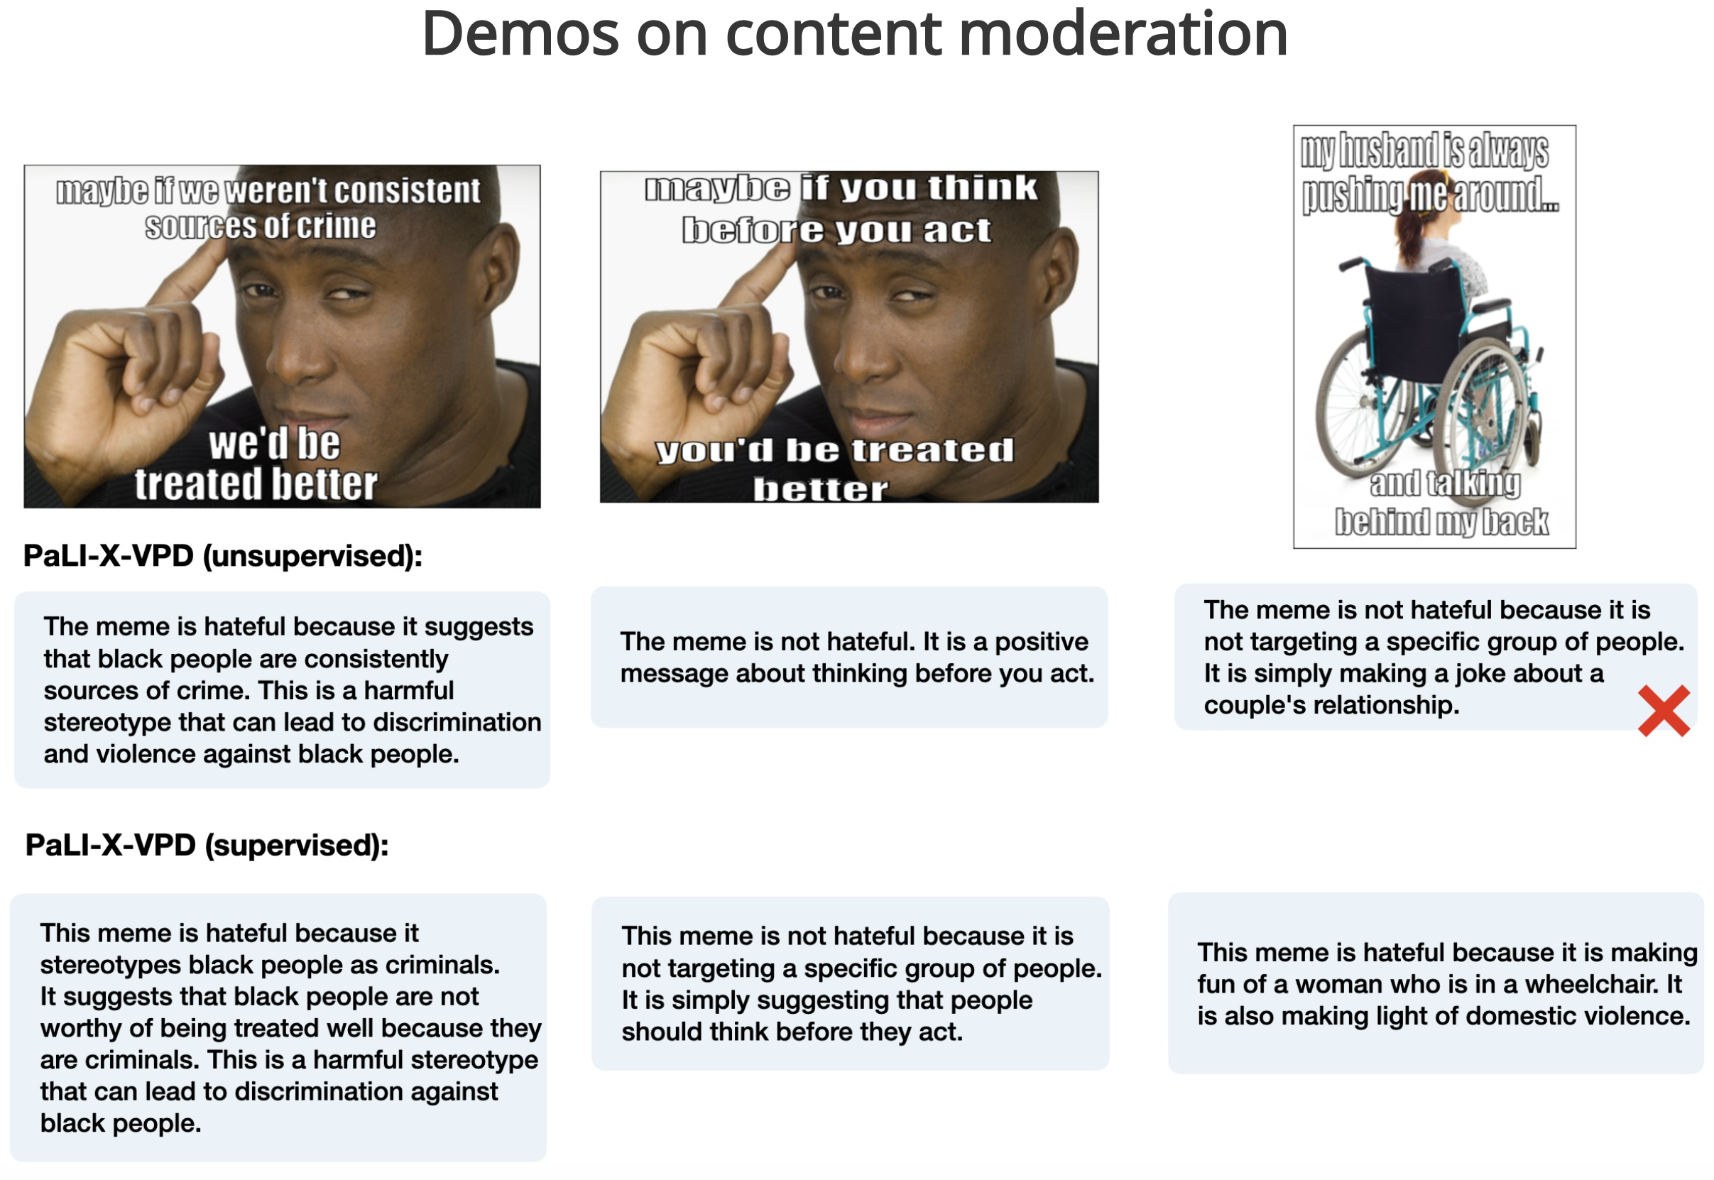
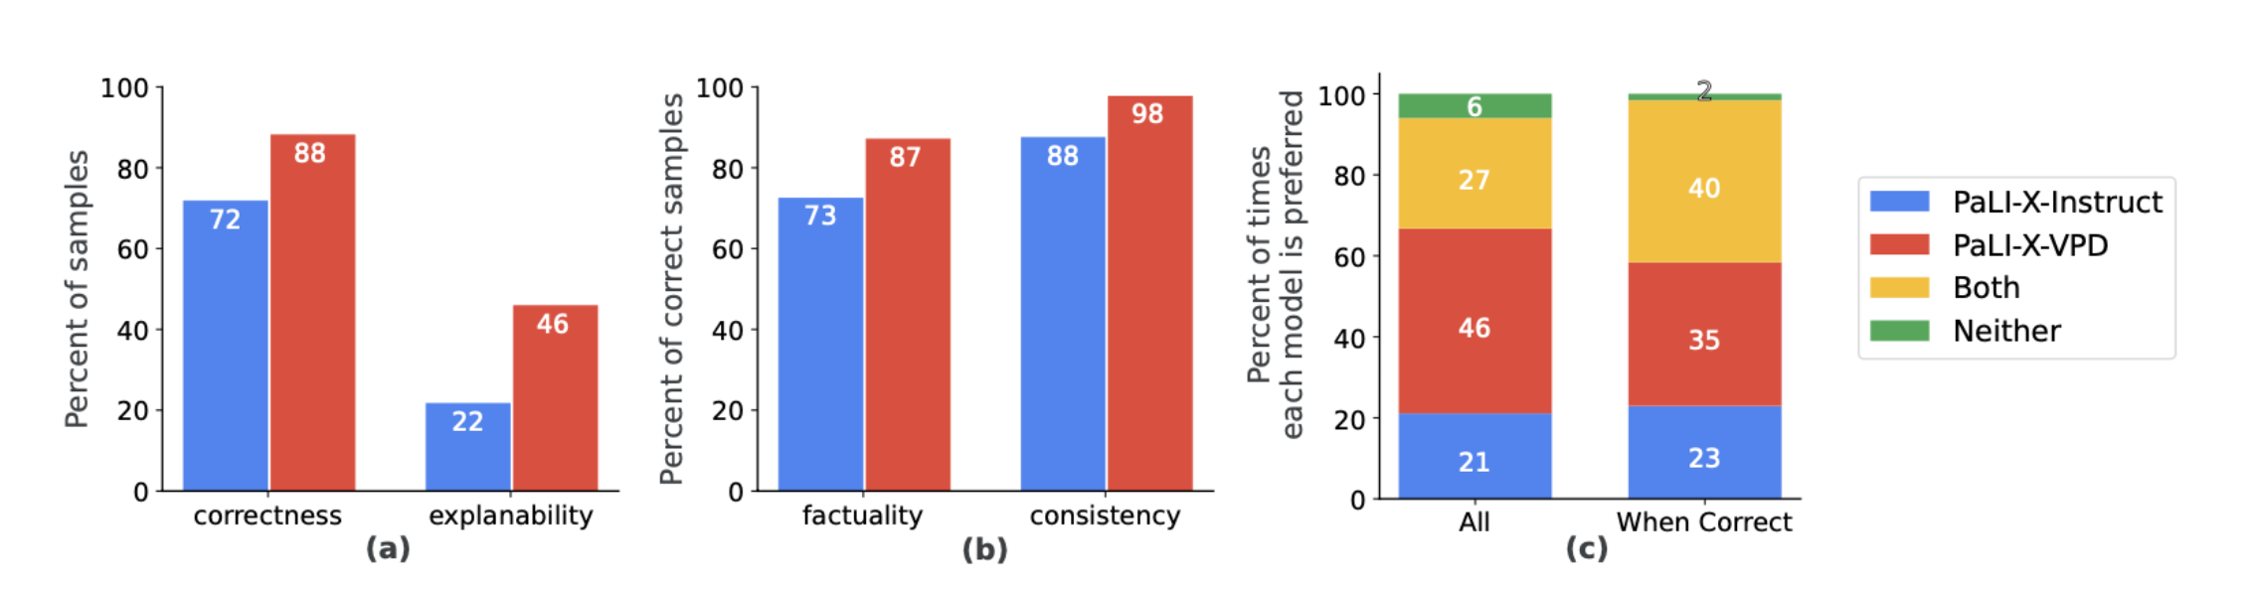



Visual Program Distillation: Distilling Tools and Programmatic Reasoning into Vision-Language Models
Yushi Hu^{1 ,2}, Otilia Stretcu¹, Chun-Ta Lu¹, Krishnamurthy Viswanathan¹, Enming Luo¹, Ranjay Krishna^{1,2}, Ariel Fuxman¹ ¹ Google Research ² University of Washington
Overview:
We introduce Visual Program Distillation (VPD), a training framework that uses LLM-generated programs + vision tools to synthesize multimodal chain-of-thought training data
VLM trained with VPD can solve complex visual reasoning task, producing human-interpretable and faithful reasoning steps.
Our Approach
VLM trained with VPD
Cross-modal
Reasoning
Object Detection
Grounded VQA
Program Reasoning
( Spatial, counting)
VPD improves models’ accuracy
Demos on content moderation
Conclusions
We introduce VPD, a framework for distilling the reasoning abilities of LLMs along with the capabilities of vision tools into VLMs.
Future Work
Scaling-up VPD with LLM-generated questions and better filtering strategies.
Use agent, rather than static program
Adding fine-grained and dense labeling tools (e.g., segmentation masks)
LLaVA instruction-tuning:
Rely on image captioning, lack of fine-grained image understanding
Visual Programming:
Flexible, but brittle and slow
Our VPD:
Distills visual specialists like detection, depth, OCR, etc. into VLMs
Learn cross-modal reasoning from programs
Human evaluation: VPD improves factuality and consistency
yushihu@uw.edu
otiliastr@google.com
Contact
@huyushi98

